Slide 1
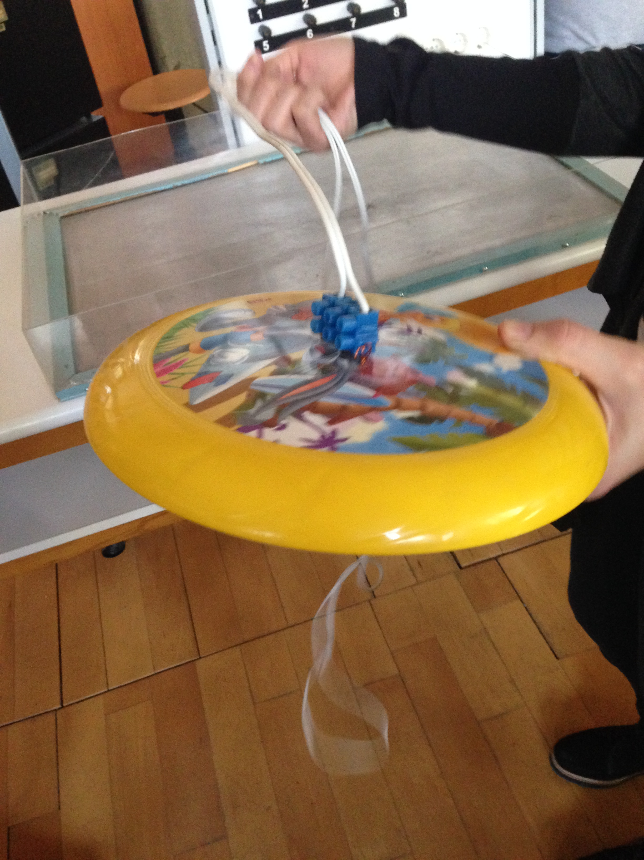
FRISBEE DEMO
it is MAGLEV ,not ultimate

Slide 2
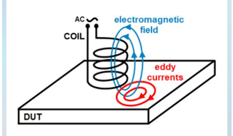
EDDY CURRENT
Eddy current are induced current in shape of loop within conductors due to changing magnetic fields. (Faraday's Law)
The current flows in perpendicular to magnetic field and the concentrates near the surface of conductor. (Depth of Penetration)

Slide 3
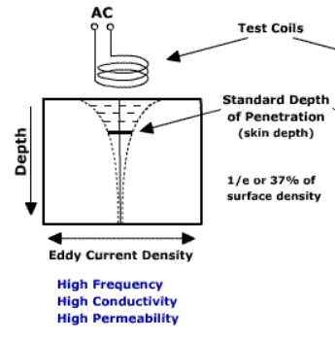
Influencing Factors of Eddy Current
Strength of current changes with:
The strength of magnetic field proportionally.
The are of loop proportionally.
The rate of change flux proportionally.
The resistivity of material inversely proportional.
Location of eddy current chages with:
Frequency
Conductivity
Permeability

Slide 4
Funny Links that can be informative
Imagine It - Eddy current science
Copper’s Surprising Reaction to Strong Magnets
Eddy Current Brake Experiment

Slide 5

Avoding or Using Eddy Current ?
Eddy current is unwanted at transformers, inductors and electric motors because of power losses.
The power losses are about basically current flow and resistance of conductors. Also, operation frequency changes losses.
(Eddy Current Loss)
For avoiding the loss, ‘Lamination’ is used.
(Core Construction of Power Transformers)
Dark Side of Eddy Current

Slide 6

There are more applications such as:
-Electromagnetic braking
-Identification of metals
-Attractive effects
-Vibration and position sensing
-Levitation (Repulsive effects).
Electromagnetic Brakes - How they work
May the Eddy Current be
with you

Slide 7
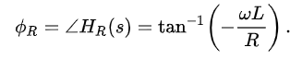
Magnetic Levitation
Induced current by changing magnetic field creates a opposite magnetic fields within conductors.
The magnetic field cretates a induced emf with 90 degree phase.
If conductivity of material is enough large, eddy current from induced emf is out of phase with inductor current because the current phase depends on below formula at basic R-L circuit.(RL_circuit)

Slide 8
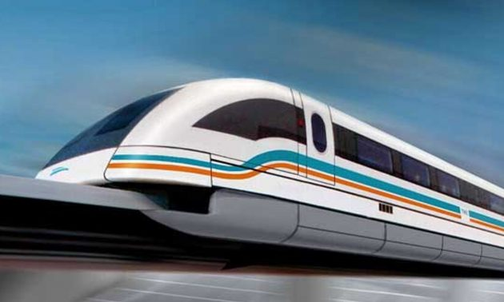
Thus,the conductors behaves like ‘diamagnetic materials’. Diamagnetic materials are repelled by magnetic field.
This principle is used for some region.
Eddy Current Non Ferrous Separator
Maglev Train

Slide 9
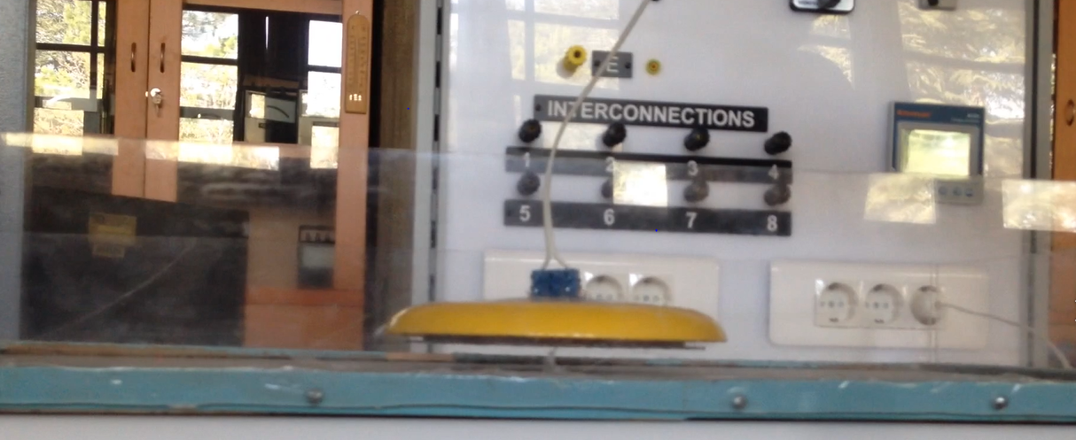
MAGLEV FRISBEE
A frisbee can float on air with the help of magnetic levitation.

Slide 10
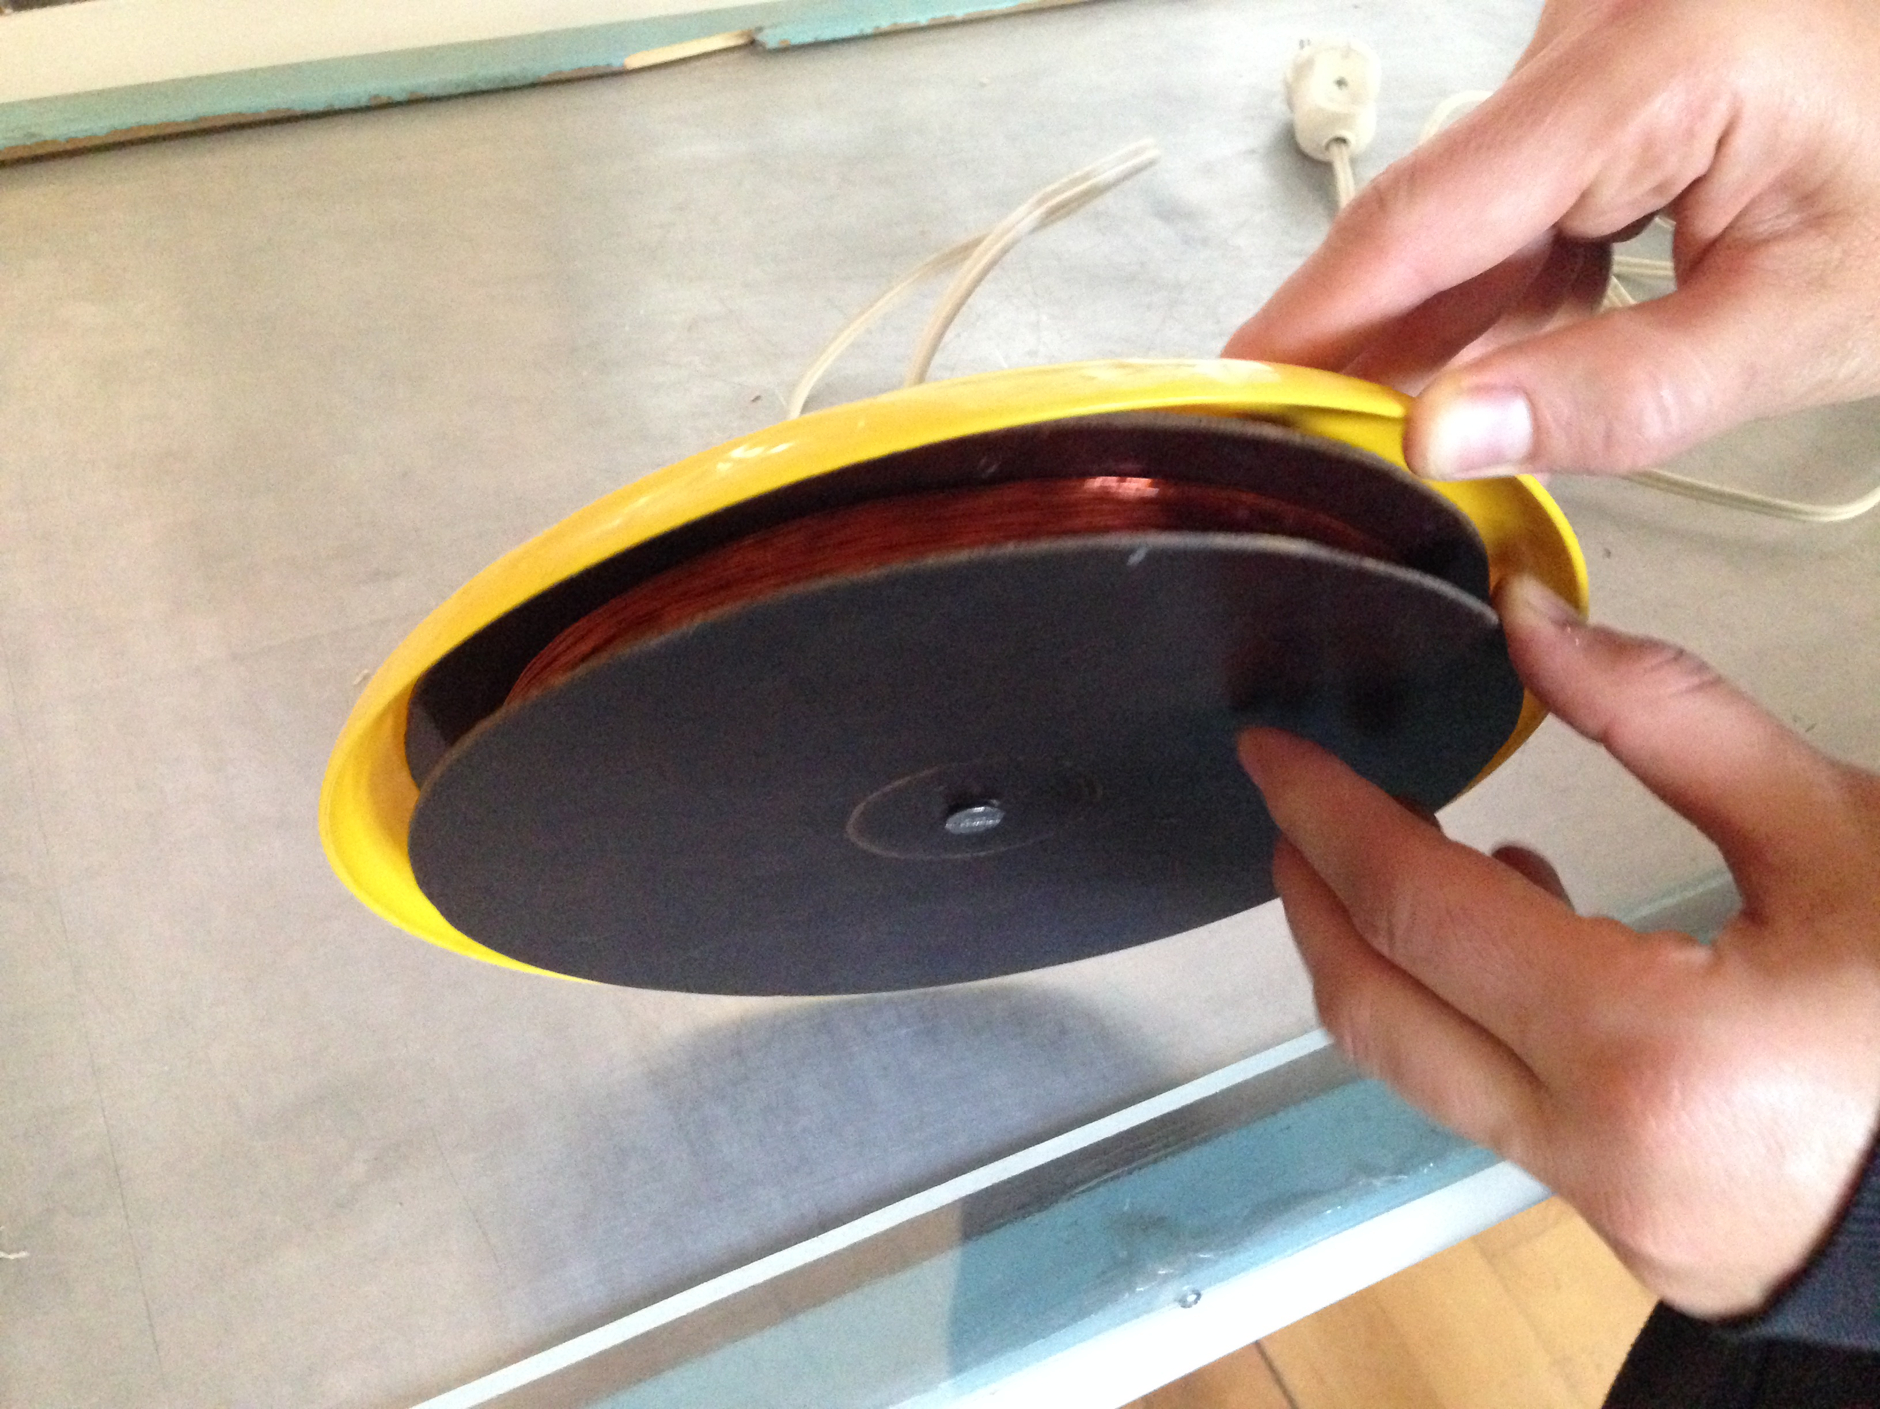
How?
The frisbee has a inductor inside to create a changing magnetic field.
The inductor is excited by sockets.(Mains 220Vrms 50 Hz)
This creates a changing magnetic field at bulk.

Slide 11
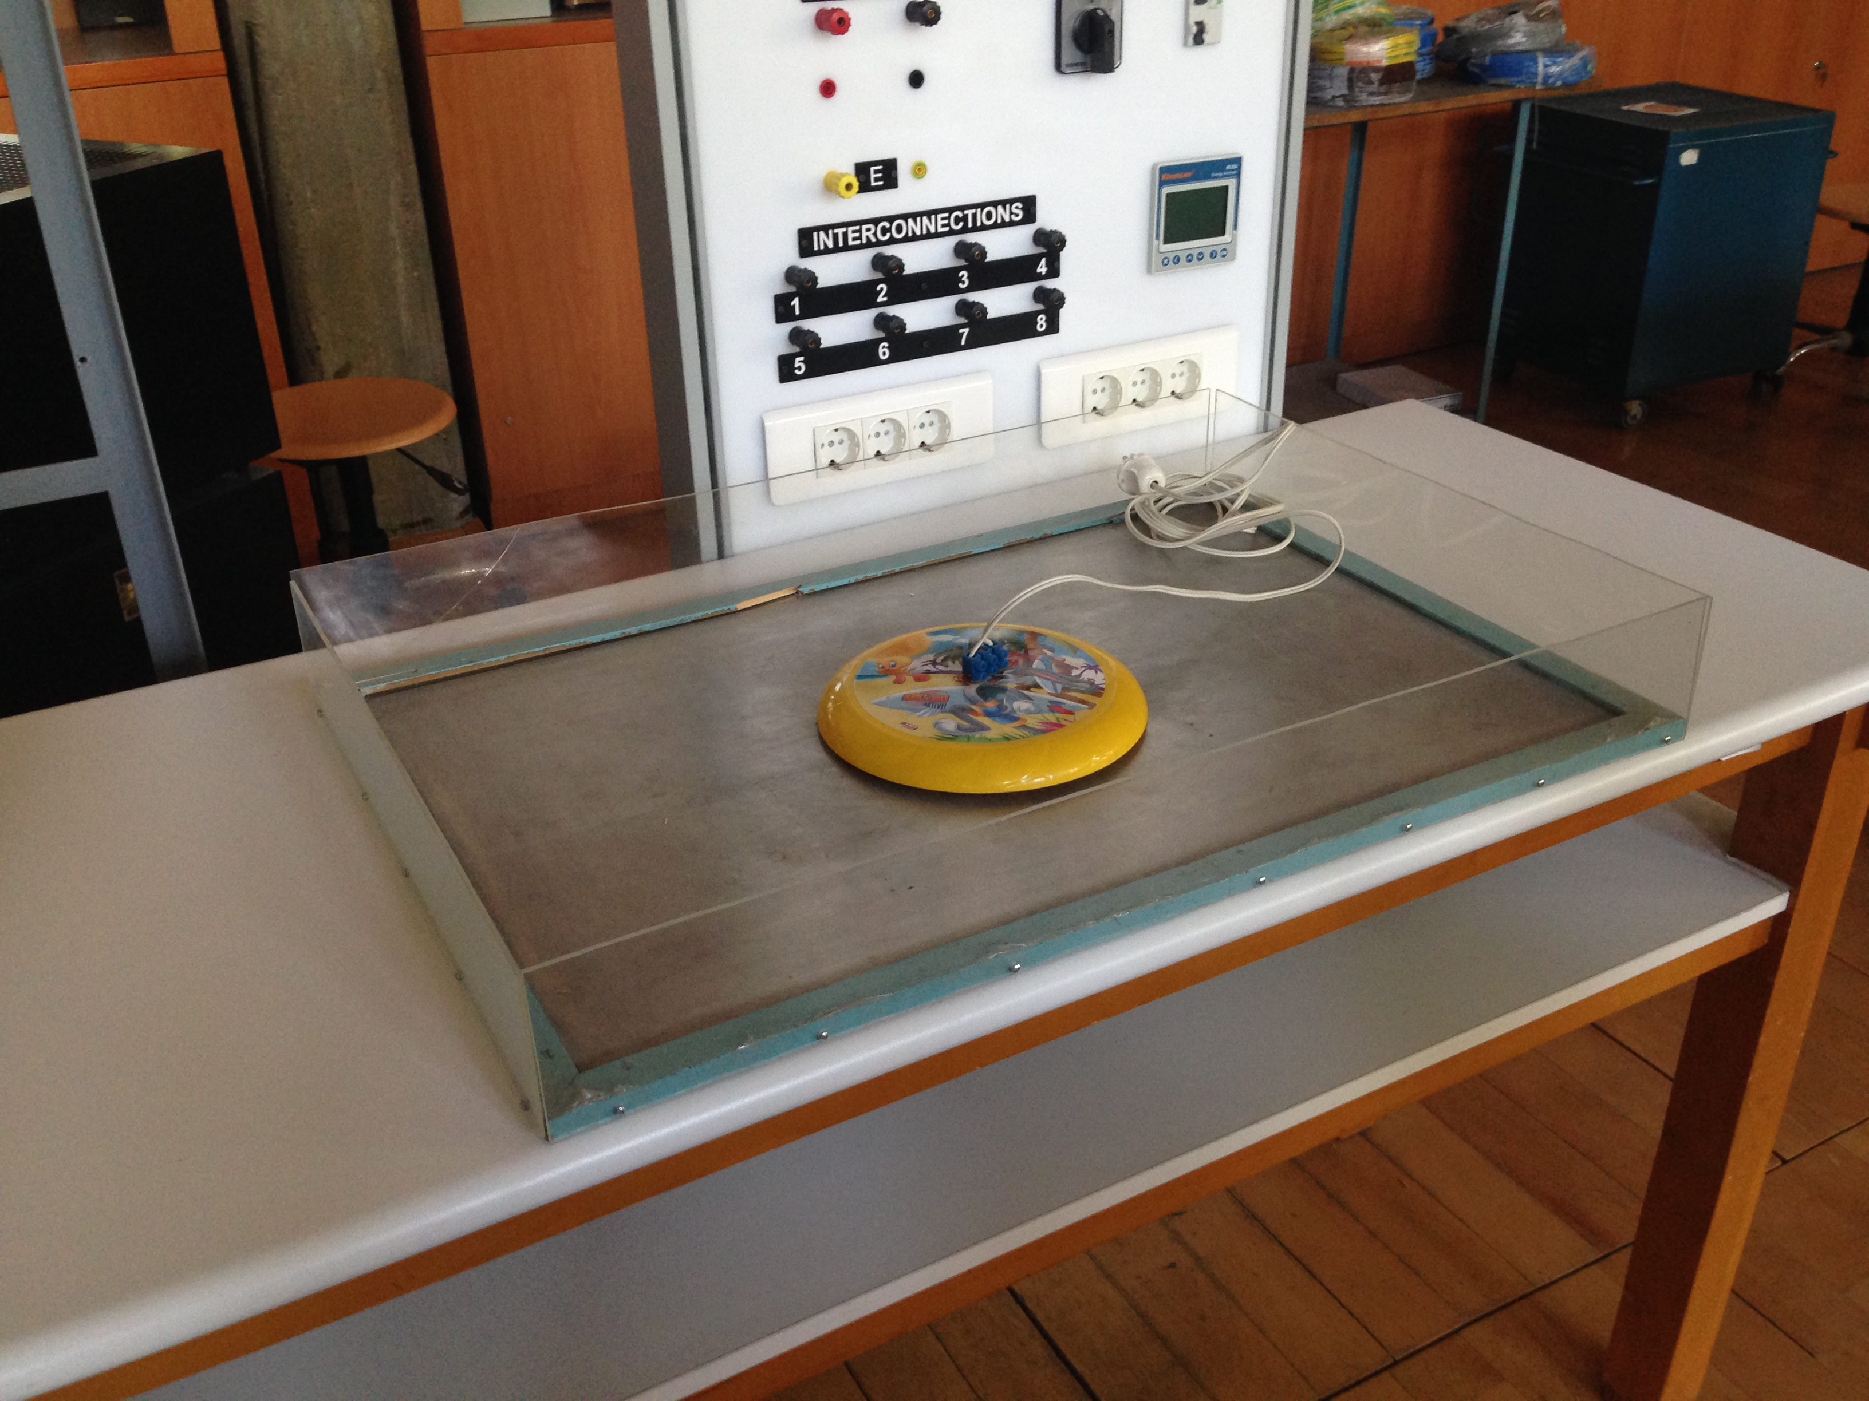
Conductor bulk is below the frisbee.
Eddy currents flow on surface.

Slide 12
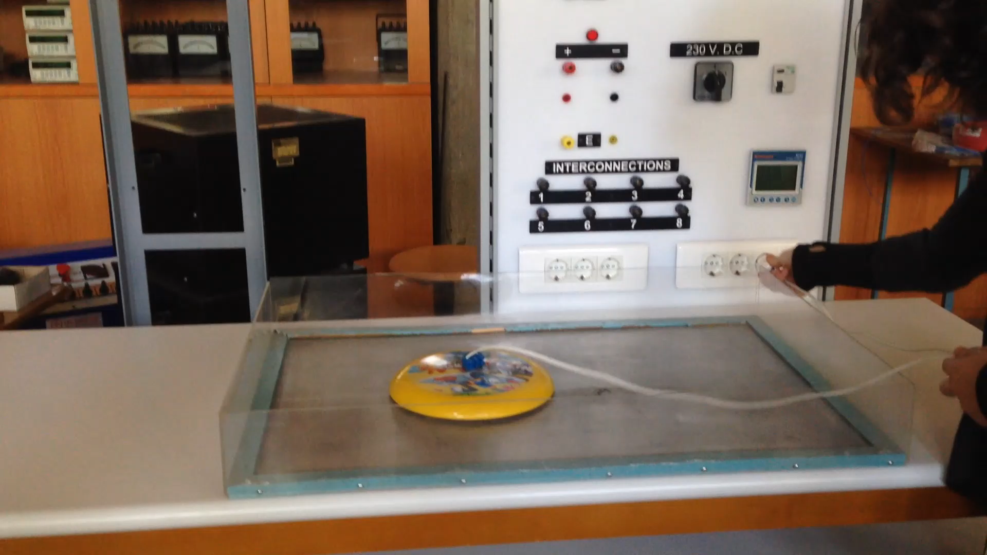
Demonstration

Slide 13
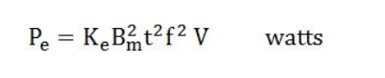
Heating Up
The setup works for 5 minutes because of heating. All power loss from eddy current is converted heat.( Levitation Coil - Induction Heating)
Ke is eddy coefficient and t is thickness of lamination.
As seen, the heat depends on excited current and frequency.

